Slide 1
Statistical Methods for Magnetic Field Estimation
Arbaaz Khan
Dept. of Electrical & Computer Engineering
McGill University
Presentation Series
June 13th, 2018
Notes:
Adapted from McGill University’s Structural Dynamics & Vibrational Lab: http://structdynviblab.mcgill.ca/download.html
This program can be redistributed and/or modified under the terms of GNU public license.

Slide 2
Outline
Introduction | Deep Networks | Results | Recurrent Neural Nets | Expansion | Questions
Introduction
Advancements in Machine Learning
Types of Deep Learning
Deep Networks
Artificial Neural Networks
Convolutional Neural Networks
Results
ConvNets / CNNs
Recurrent Neural Nets
Issues with CNN
RNN – working
Expansion
Machine Design
Notes:
To change the footer details (i.e. name, topic, date), select the View tab and click on Slide Master. Navigate to the 3rd slide and edit the footer content (shown as a 3-column table). This will remain fixed throughout all your slides except for the title slide.
To fade a part of text or figure, use a box with a transparency of 25%. Or, click on the faded box shown above, select the box and copy it anywhere you want.
The total number of pages, shown in the lower-right corner as 5, should be adjusted manually in the Slide Master. Unfortunately, we could not find a way to handle it automatically (maybe macros?). Changing slide number is already handled automatically.
In the header (where the main topics are mentioned as a table), highlighting the current topic as a bold text should be performed manually. This table must be copied and edited manually into new slides.
If you need to change or delete the background pictures, go to the Slide Master. Any changes there would affect relevant slides.

Slide 3
Advancements in Machine Learning - Recent Trends
Introduction | Deep Networks | Results | Recurrent Neural Nets | Expansion | Questions
Although Deep Learning has gained a lot of importance in recent times, it has been in existence since 1940.
Some factors that are directly responsible for the growth in past few years are:
Computation Power (GPUs, ASICs, TPU).
Data.
Improvement in algorithms (CNN , LSTM).
Infrastructure & Frameworks (Git, Cloud Computing, Tensorflow).
Why not use these models for design & analysis of Electrical machines?
A computationally cheap & accurate field solution is necessary for analysis of electromagnetic devices such as actuators, transformers, and electric machines.

Slide 4
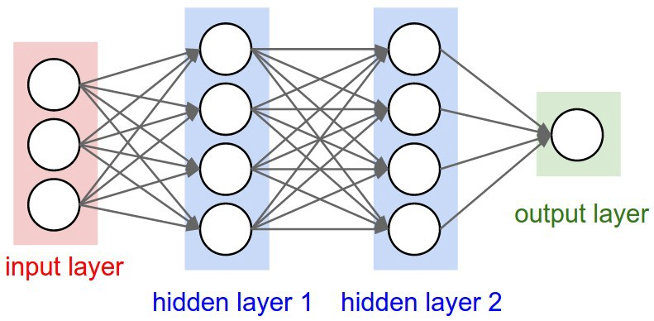
ANN - Introduction
Introduction | Deep Networks | Results | Recurrent Neural Nets | Expansion | Questions
Neural Networks are modeled as collections of neurons that are connected in an acyclic graph.
A loss function (dependent on training data and weights) measures the quality of a particular set of parameters based on how well the induced scores agreed with the ground truth target in the training data.
Figure: A feed-forward neural network

Slide 5
Statistical Methods for Magnetic Field Estimation
Thank you!
Questions or Comments?
McGill University
Presentation Series
Visit our website: http://www.compem.ece.mcgill.ca
Email address: arbaaz.khan@mail.mcgill.ca

